Slide 1
Introduction to Confidence Intervals

Slide 2
Background information on Inference
What is a Confidence Interval?
How to calculate a Confidence Interval?
Simulation
Theory
Drawing Conclusions
Schedule

Slide 3
Background
Generally, our goal in statistics is to gather information from a sample and then generalize the results from the sample to some larger population of interest.
This is done by calculating statistics – numerical properties of the sample – and using them to estimate parameters – numerical properties of the population.
This process is called statistical inference.
Is this value of the parameter plausible?

Slide 4
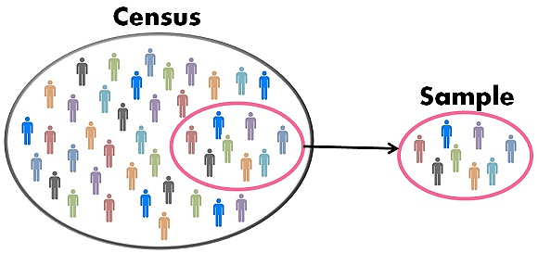
Overall Idea
We want to know about the population, and to do so, must work with the sample
Population
Sample
Can’t observe directly!
Parameter
(population characteristic)
Inference
Statistic
(sample characteristic)

Slide 5
Terminology
The whole purpose of statistics is to understand a set of information. This set of information is from a . . .
Population is the complete collection of ALL elements that are of interest for a given problem.
Parameter is the numerical measurement used to describe a population.
The population is often so big that obtaining all information about its elements is either difficult or impossible. So, we work with a more manageable set of data that we obtain from a . . .
Sample is sub-collection of elements drawn from a population.
Statistic is the numerical measurement used to describe a sample.

Slide 6

Example: Tire Story Falls Flat
A legendary story on college campuses concerns two students who miss a chemistry exam because of excessive partying but blame their absence on a flat tire. The professor allows them to take a make-up exam, and sends them to separate rooms to take it. The first question, worth 5 points is quite easy. The second question, worth 95 points, asks: Which tire was it?
It has been conjectured that students select the front right more than would be expected with random chance.
Research Question – Do students pick which tire when flat in equal proportions?
To test this conjecture 32 students were asked, if they were in this situation, which tire would they say had gone flat. The results are as follows:
What is the population of interest?
What is the sample?
Left Front | Left Rear | Right Front | Right Rear
7 | 5 | 15 | 5

Slide 7
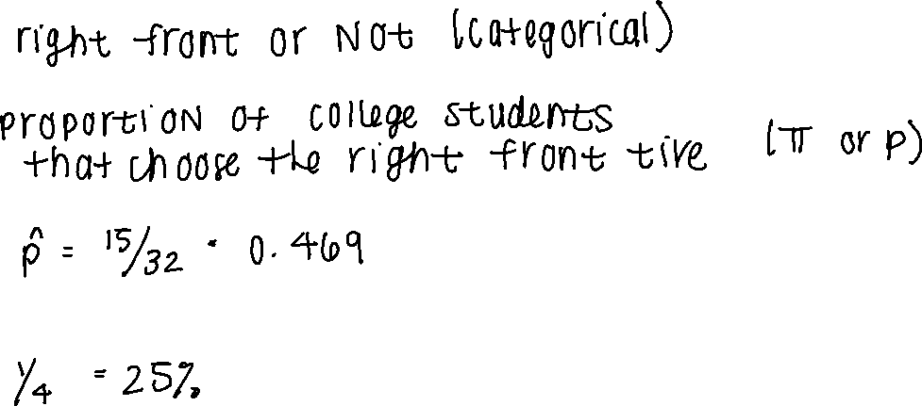
Example: Tire Story Falls Flat
What is the variable of interest?
Define parameter of interest.
Calculate the observed statistic.
Suppose students have no preference. How many in the sample would you expect to choose the right front tire?

Slide 8

Brief Overview of Hypothesis Testing
Summarize the research question and parameter of interest
Null hypothesis: what occurs due to random chance (written as $H_{0}$)
Alternate hypothesis: what the researcher is trying to support or what occurs if there is an effect (written as $H_{a}$ or $H_{1}$)
We start by assuming null hypothesis is true and look for evidence to reject this idea

Slide 9
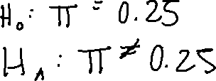
Alternative Hypothesis
One-sided test: testing for either less (<) than OR greater than (>) in the alternate hypothesis
Two-sided test: testing for “not equal to (≠)” in the alternate hypothesis
What are the hypotheses for the Tire Story Example?

Slide 10
Decision
Inference involves using the sample to decide one of the following two:
The sample supports the research question – Reject H₀ in favor of H_{a}.
The sample does not support the research question – Fail to reject H₀ in favor of H_{a}.
Must answer the following: How unusual would it be to a observe a result as extreme or more extreme by random chance alone (i.e. if the null is true)?
Decision commonly made using p-values or standardized statistics (z-test, t-test)

Slide 11
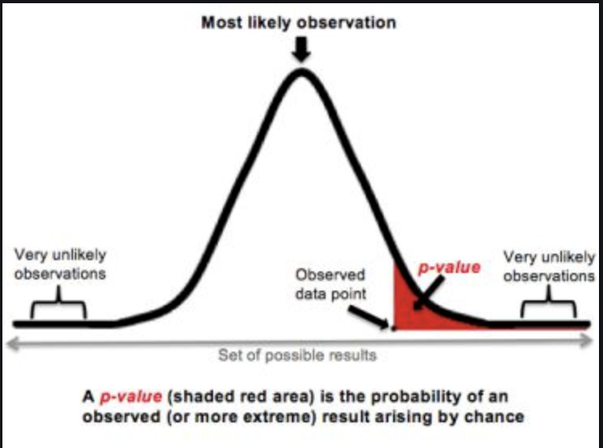
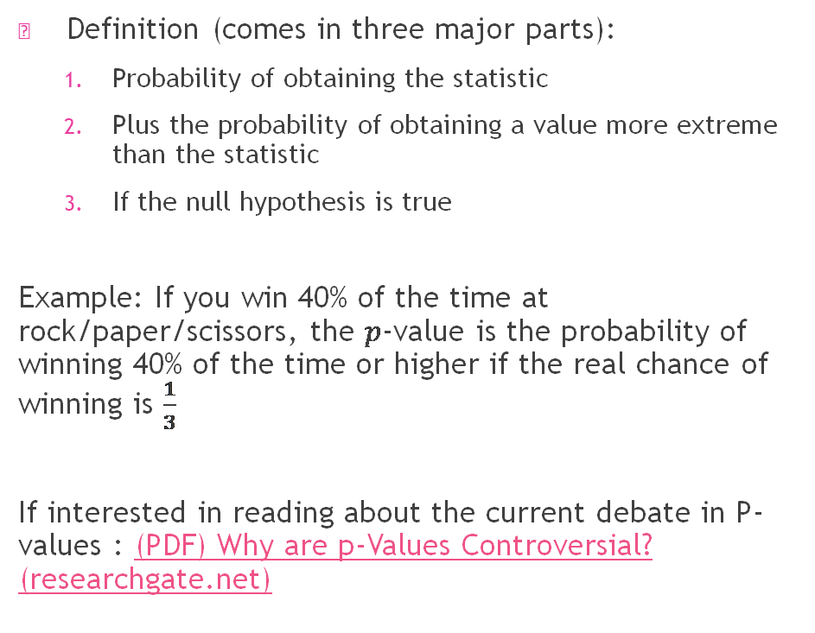
P-Values
Definition (comes in three major parts):
Probability of obtaining the statistic
Plus the probability of obtaining a value more extreme than the statistic
If the null hypothesis is true
Example: If you win 40% of the time at rock/paper/scissors, the $p$-value is the probability of winning 40% of the time or higher if the real chance of winning is $\frac{1}{3}$
If interested in reading about the current debate in P-values : (PDF) Why are p-Values Controversial? (researchgate.net)

Slide 12
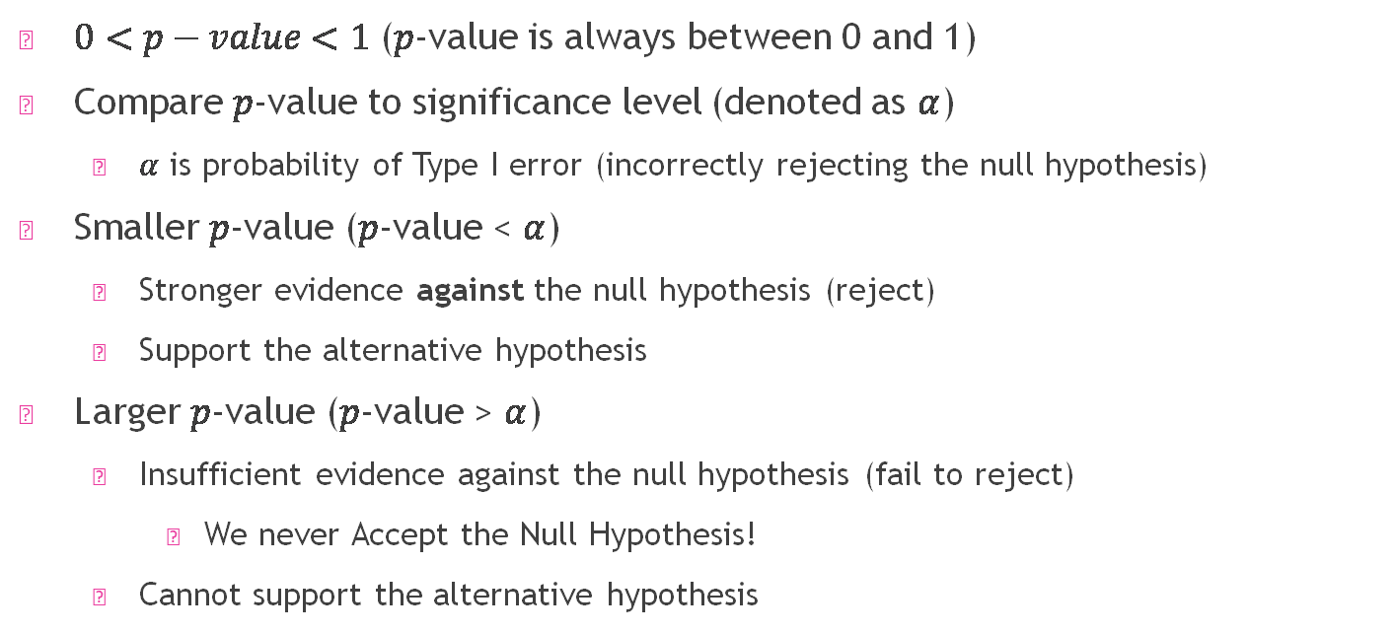
P-Values
$0<p−value<1$ ($p$-value is always between 0 and 1)
Compare $p$-value to significance level (denoted as $α$)
$α$ is probability of Type I error (incorrectly rejecting the null hypothesis)
Smaller $p$-value ($p$-value < $α$)
Stronger evidence against the null hypothesis (reject)
Support the alternative hypothesis
Larger $p$-value ($p$-value > $α$)
Insufficient evidence against the null hypothesis (fail to reject)
We never Accept the Null Hypothesis!
Cannot support the alternative hypothesis

Slide 13
New Goal: Estimation
What values of the parameter are plausible?
Statisticians typically do this with a confidence interval?
Confidence Interval: A range of likely values for the parameter of interest

Slide 14
Who doesn’t read books in America?
In a Pew Research Center a survey of U.S. adults conducted from Jan. 25-Feb. 8, 2021, asked the question: “Have you read a book in the past year, whether in print, electronic, or audio form?” Of the 1,502 US adults surveyed, 345 (23%) answered they have not read a book in the past year. They want to know if the proportion of US adult who have not read a book in the past year is different from 25%.
Ultimately, the Pew Research Center conducted this poll because they wanted to estimate the proportion of US adults in that (at the time of the survey) have not read a book in the past year. Keep this in mind as you answer the following questions.
Who doesn’t read books in America? | Pew Research Center

Slide 15
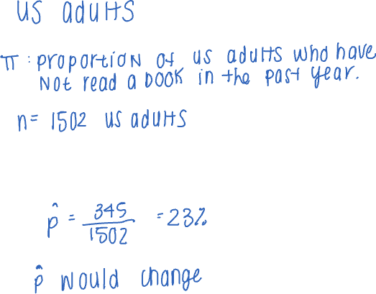
Who doesn’t read books in America
What is the population of interest?
What is the parameter of interest?
What is the sample?
What is the observed statistic of interest?
This is called a point estimation
What if we took a different sample of 1502 US adults?
In a Pew Research Center a survey of U.S. adults conducted Jan. 25-Feb. 8, 2021, which asked the question: “Have you read a book in the past year, whether in print, electronic, or audio form?” Of the 1,502 US adults surveyed, 345 (23%) answered they have not read a book in the past year. They want to know if the proportion of US adult who have not read a book in the past year is different from 25%.

Slide 16
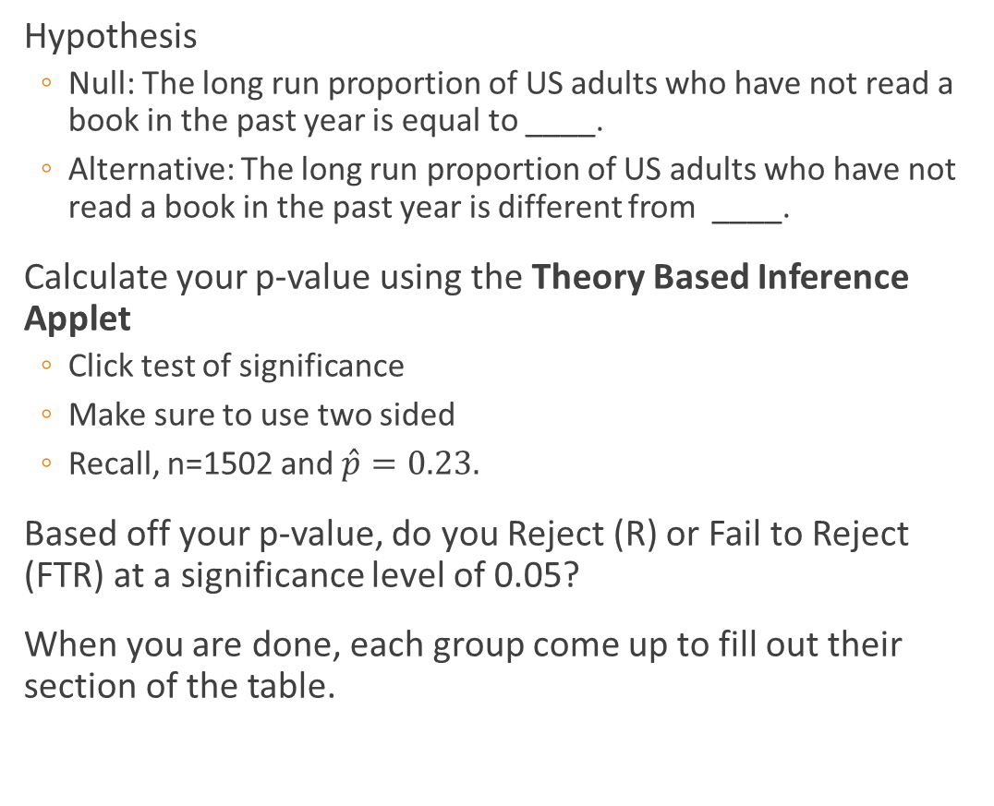
Who doesn’t read books in America
Hypothesis
Null: The long run proportion of US adults who have not read a book in the past year is equal to ____.
Alternative: The long run proportion of US adults who have not read a book in the past year is different from ____.
Calculate your p-value using the Theory Based Inference Applet
Click test of significance
Make sure to use two sided
Recall, n=1502 and $\hat{p}=0.23.$
Based off your p-value, do you Reject (R) or Fail to Reject (FTR) at a significance level of 0.05?
When you are done, each group come up to fill out their section of the table.
In a Pew Research Center a survey of U.S. adults conducted Jan. 25-Feb. 8, 2021, which asked the question: “Have you read a book in the past year, whether in print, electronic, or audio form?” Of the 1,502 US adults surveyed, 345 (23%) answered they have not read a book in the past year. They want to know if the proportion of US adult who have not read a book in the past year is different from 25%.

Slide 17
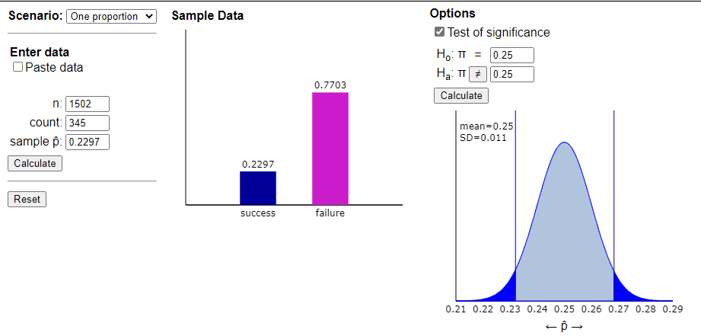
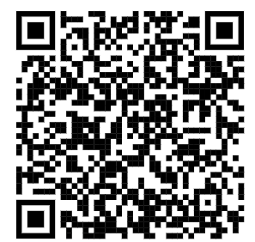

Theory Based Inference Applet
Each group will have a different value
Calculate your p-value using the Theory Based Inference
Click test of significance
Make sure to use two sided
Recall, n=1502 and
$$\hat{p}=0.23$$
Everyone's will look like this
Theory-Based Inference Applet (rossmanchance.com)

Slide 18
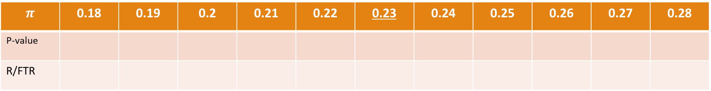
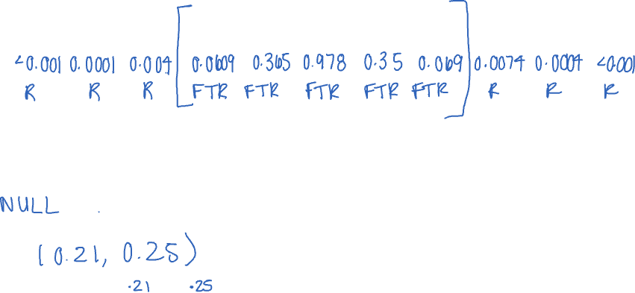
1 2 3 4 5 6 7 8 9 10 11
$$π$$ | 0.18 | 0.19 | 0.2 | 0.21 | 0.22 | 0.23 | 0.24 | 0.25 | 0.26 | 0.27 | 0.28
P-value
R/FTR
What trends do we see?
When we Fail to Reject are we saying the null or alternative is plausible?
What is the interval of plausible values?
Interpretation: We are 95% confident that the long-run proportion of US adult who have no read a book in the past year is between ____ and ____.

Slide 19
The General Form of a Confidence Interval
Notice, our confidence interval is centered around our observed statistic
Confidence interval = observed statistic ± margin of error
For this example, recall that the sample statistic is = 23%. The Pew Research Center reported the margin of error as follows:
Note that the confidence interval can be expressed as:
23% ± 2.9% (i.e., 20.1% ≤ π ≤ 25.9%).
This agrees with what we saw under repeated sampling on the previous page.

Slide 20

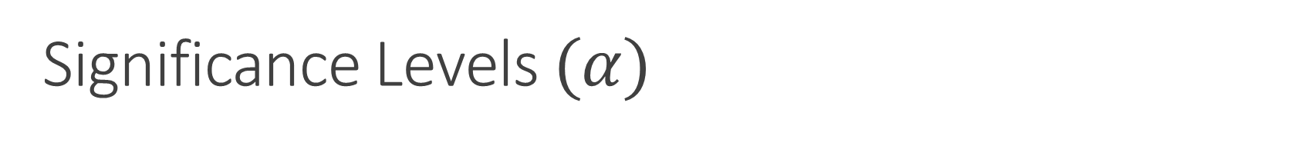
Significance Levels $(α)$
Significance Level$+$Confidence Level $= 100\%$
$α=0.10$ relates to $90\%$ confidence level
Reject when p-value $<0.10$
Narrower than 95% confidence interval
Rejecting null more often
$α=0.05$ relates to $95\%$ confidence level
Reject when p-value $<0.05$
Standard practice
$α=0.01$ relates to $99\%$ confidence level
Reject when p-value $<0.01$
Wider than 95% confidence interval
Rejecting null less often

Slide 21
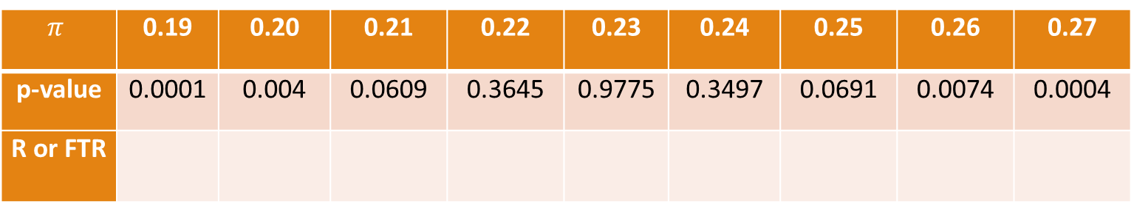
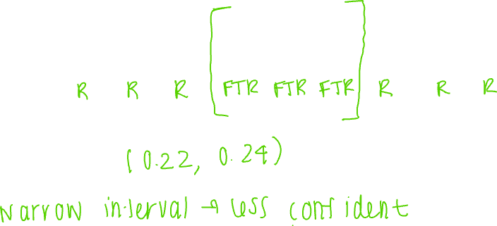
What if α=0.10?
$$π$$ | 0.19 | 0.20 | 0.21 | 0.22 | 0.23 | 0.24 | 0.25 | 0.26 | 0.27
p-value | 0.0001 | 0.004 | 0.0609 | 0.3645 | 0.9775 | 0.3497 | 0.0691 | 0.0074 | 0.0004
R or FTR

Slide 22
Faster Ways to Calculate
Testing multiple parameter values can be very tedious
So, let’s use what we know about sampling distributions to help calculate this interval

Slide 23
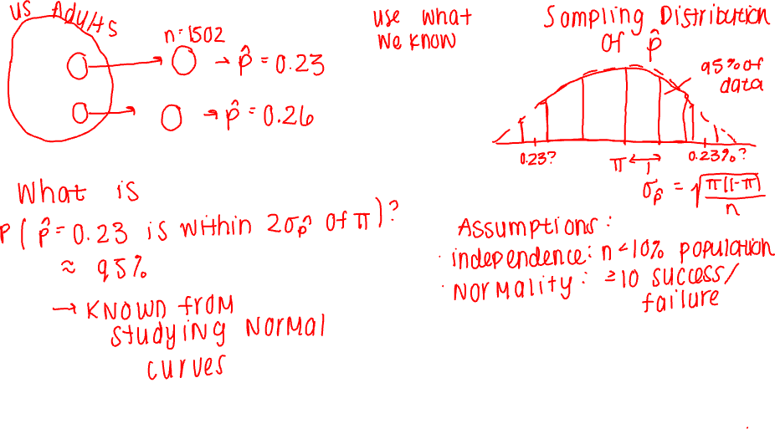

Slide 24
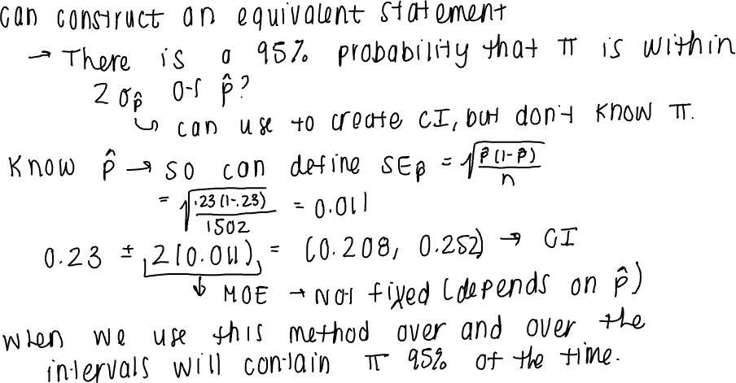

Slide 25
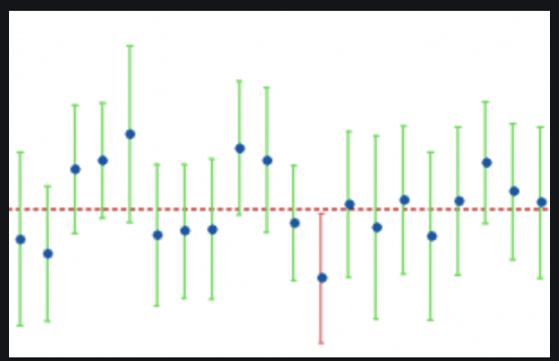
What does confidence mean?
What does “confidence” mean:
We expect 95% of all similarly constructed intervals to contain the true parameter value
A 95% confidence interval indicates that 19 out of 20 samples (95%) from the same population will contain the population parameter.
The percentage of confidence intervals that will contain the population parameter.

Slide 26
Interpretation
To interpret a confidence interval:
With 95% confidence, the true parameter value falls within the confidence interval
Incorrect: There’s a 95% chance that the true parameter values is within the confidence interval
Why? The parameter value is fixed. “Change” Implies that the parameter changes.
Example: With 95% confidence, the true proportion of US Adults that have not read a book in the past year is between 20.1% and 25.9%

Slide 27
Decision
If hypothesized value in interval – Fail to Reject
Then the hypothesized value is a plausible value of the parameter
If hypothesized value not in interval – Reject
Hypothesized value is not a plausible value of the parameter
Example:
Hypothesized value: 0.25 -> within interval -> FTR
Likely value of the parameter
We do not have evidence the true proportion of US Adults that have not read a book in the past year is different than 0.25.

Slide 28

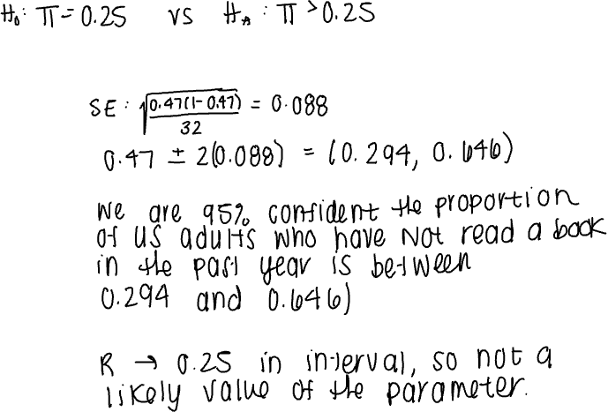
Your Turn: Tire Story Falls Flat
Calculate the Confidence Interval using the formulas
Interpret the Confidence Interval
What decision can you make (R/FTR)? Why?
A legendary story on college campuses concerns two students who miss a chemistry exam because of excessive partying but blame their absence on a flat tire. The professor allows them to take a make-up exam, and sends them to separate rooms to take it. The first question, worth 5 points is quite easy. The second question, worth 95 points, asks: Which tire was it?
It has been conjectured that students select the front right more than would be expected with random chance.
Remember $\hat{p}=\frac{15}{32}, n=32$

Slide 29
Review
A Confidence Interval is the range of likely value of the parameters.
Our confidence interval is centered around our observed statistic:
Confidence interval = observed statistic ± margin of error
A 95% confidence interval means we expect 95% of all similarly constructed intervals to contain the true parameter value

